Slide 1

Online Retail Management System Group 19
Swati Pandey
Nikhil Anil Joshi
Utkarsh Kakkar
Krishna Singh

Slide 2

Objective
The Purpose of this Database will be to eliminate the unnecessary customer’s painstaking task of searching for cheaper deals by providing him a platform wherein the system will give the prices and vendor details which eventually helps to choose best deal achieved through amalgamation of multiple websites or applications
Maintain data used to support the transaction and service provided by our platform through order information from the database.

Slide 3
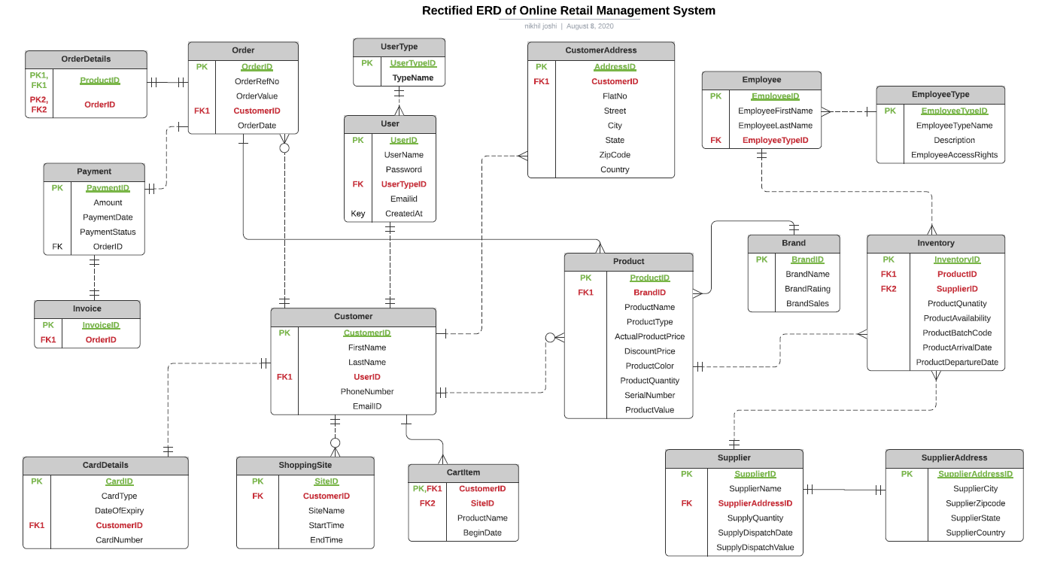
Entity Relationship Diagram(ERD)

Slide 4

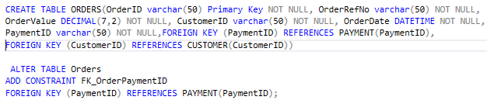
DDL Implementations
Database Creation
Tables Creation and constraints

Slide 5
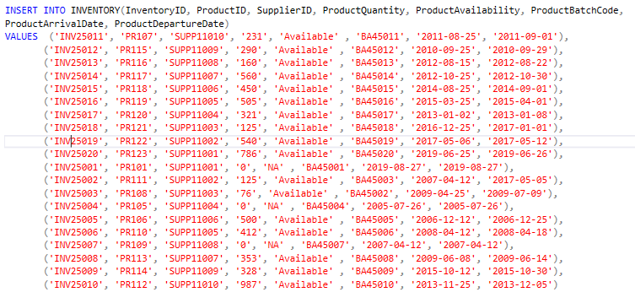
DML Implementations
Insert Statements

Slide 6
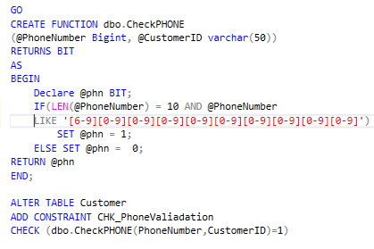
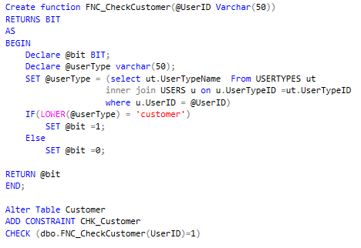
Check Constraints and Functions
Function to check PhoneNumber
Function to check UserType

Slide 7
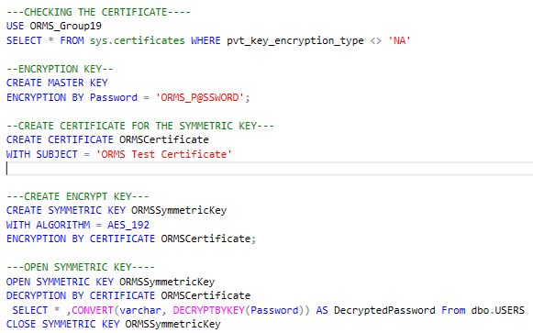
Column Data Encryption

Slide 8
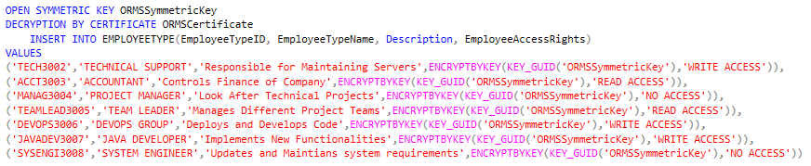
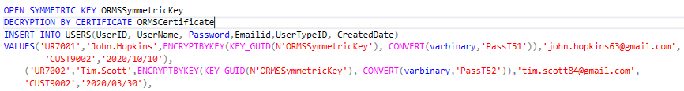
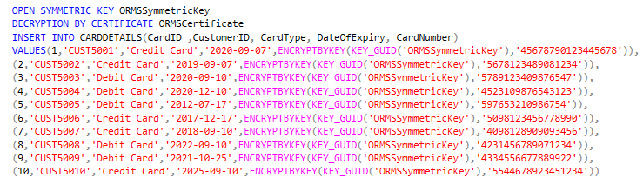
Column Data Encryption
EmployeeType
Users
CardDeatils

Slide 9
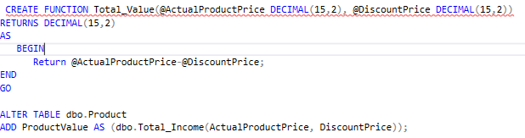
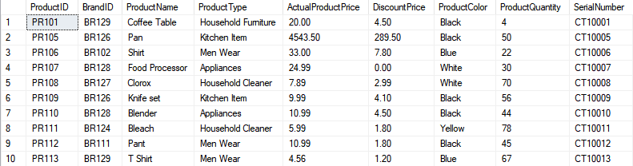
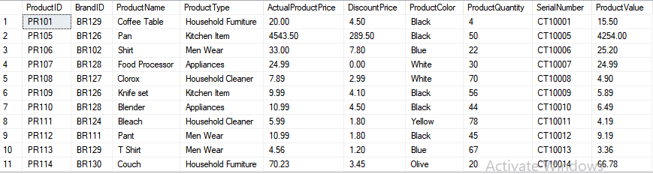
Column Based Computation
Total Value calculated based on the Actual and discounted prices in Product Table
BEFORE the function is applied to the table
AFTER the function is applied to the table

Slide 10
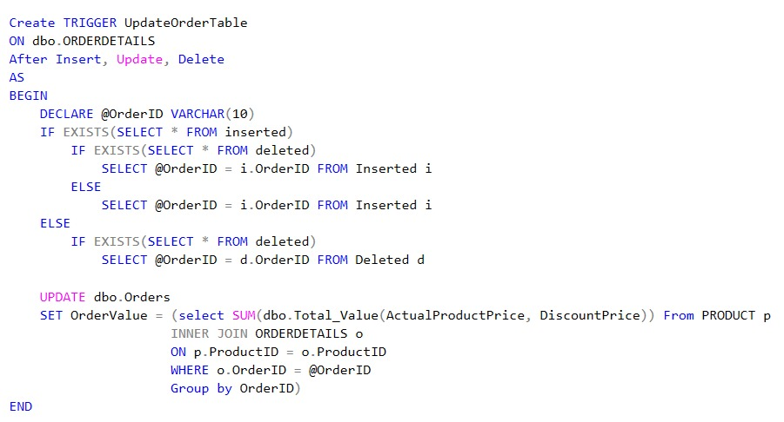
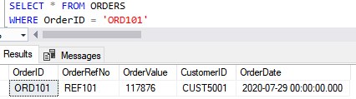
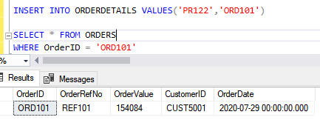
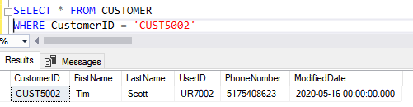
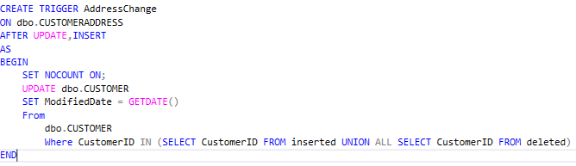
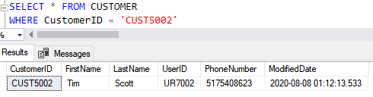
Triggers Created
Before Trigger is executed
After Trigger is executed
Before Trigger is executed
After Trigger is executed

Slide 11
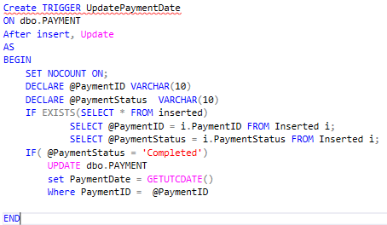
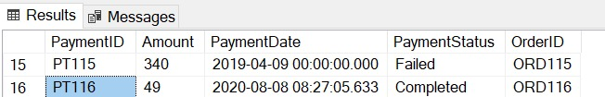
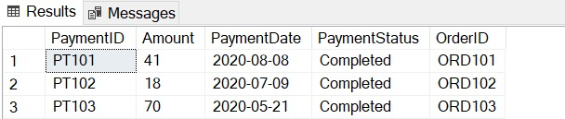
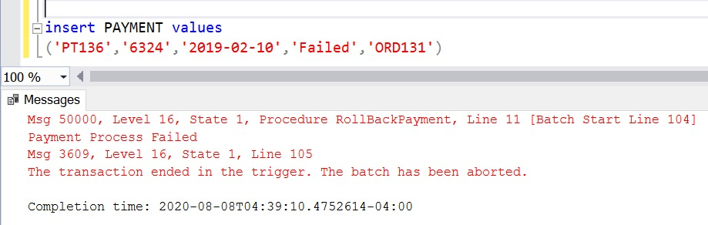
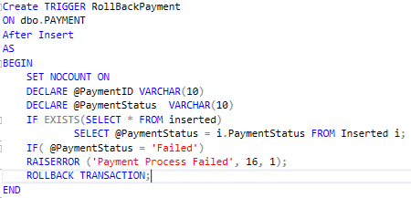
Triggers Created
Before Trigger is executed
After Trigger is executed
After Trigger is executed

Slide 12

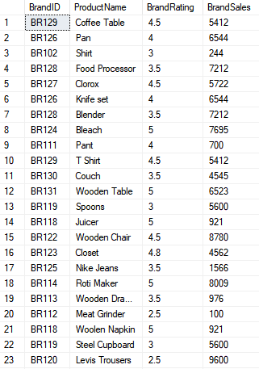
Views
View created to display the number of brand sales for each product according to the ratings given by the customers

Slide 13
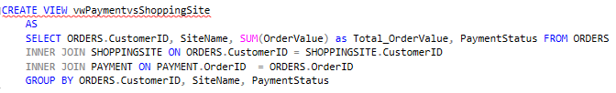
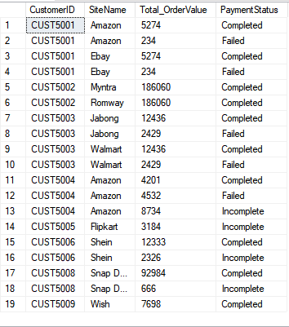
Views
View created to display each customer total order value depending upon different sites accessed to order the product

Slide 14
Reports

Slide 18
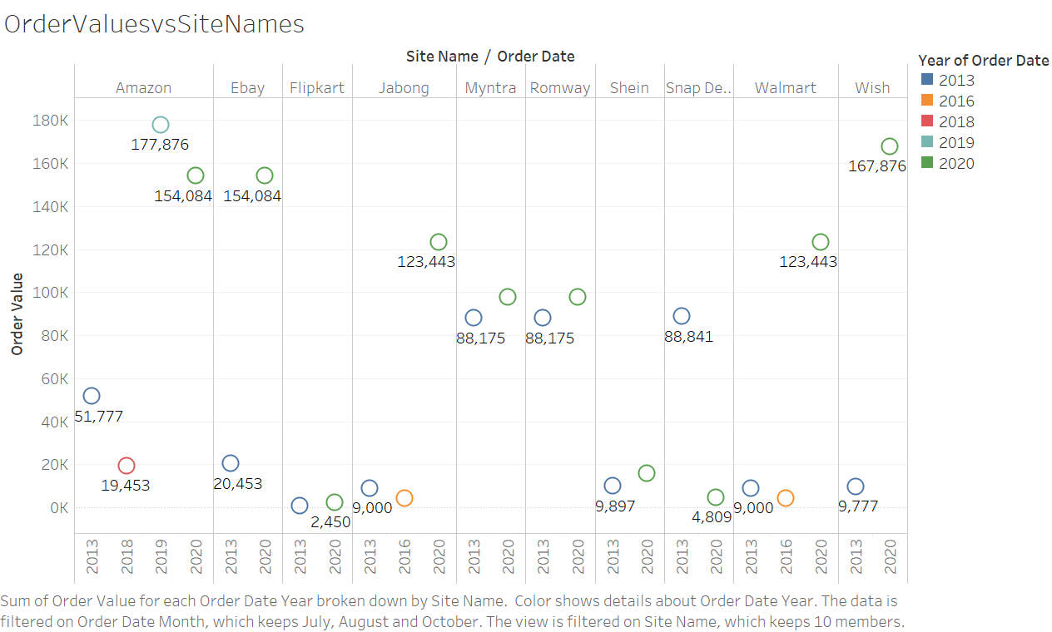
Reports on Tableau

Slide 19
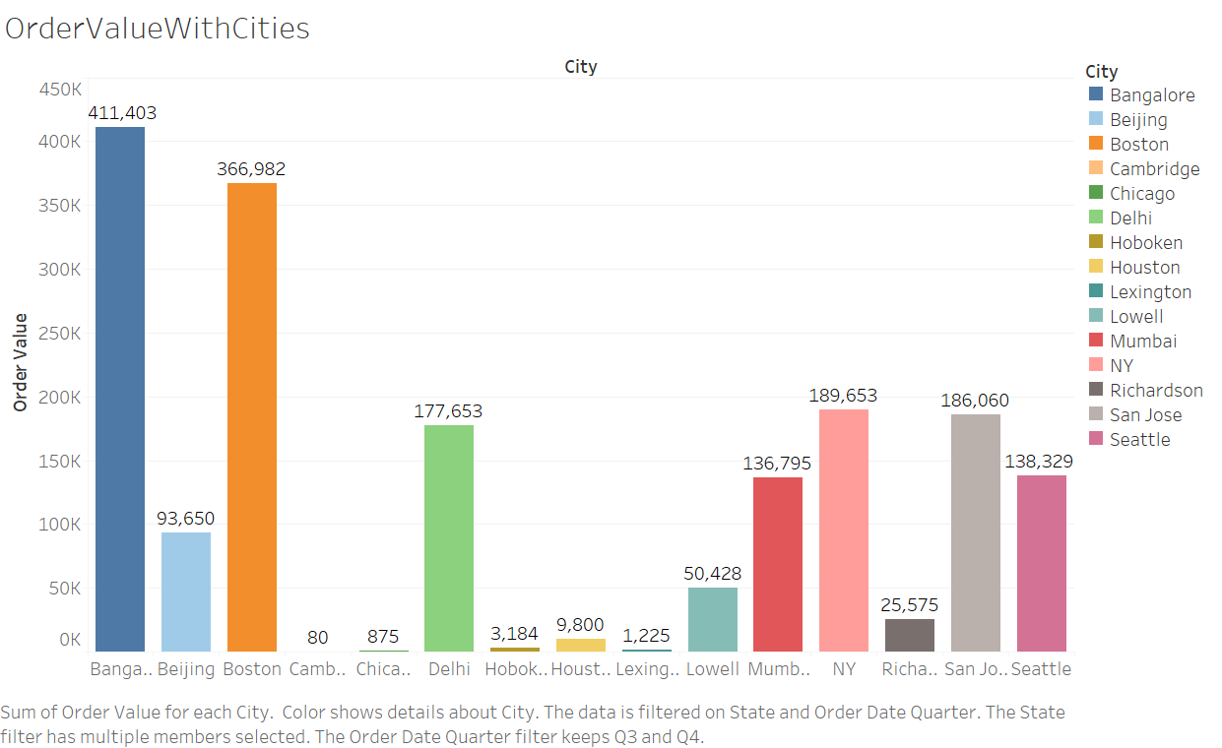
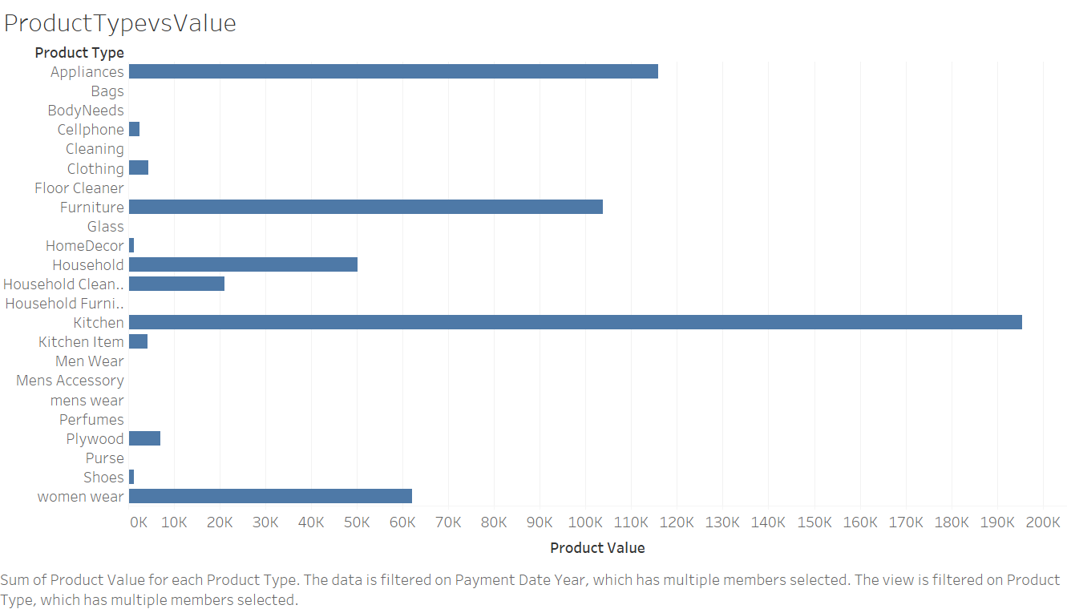

Slide 20
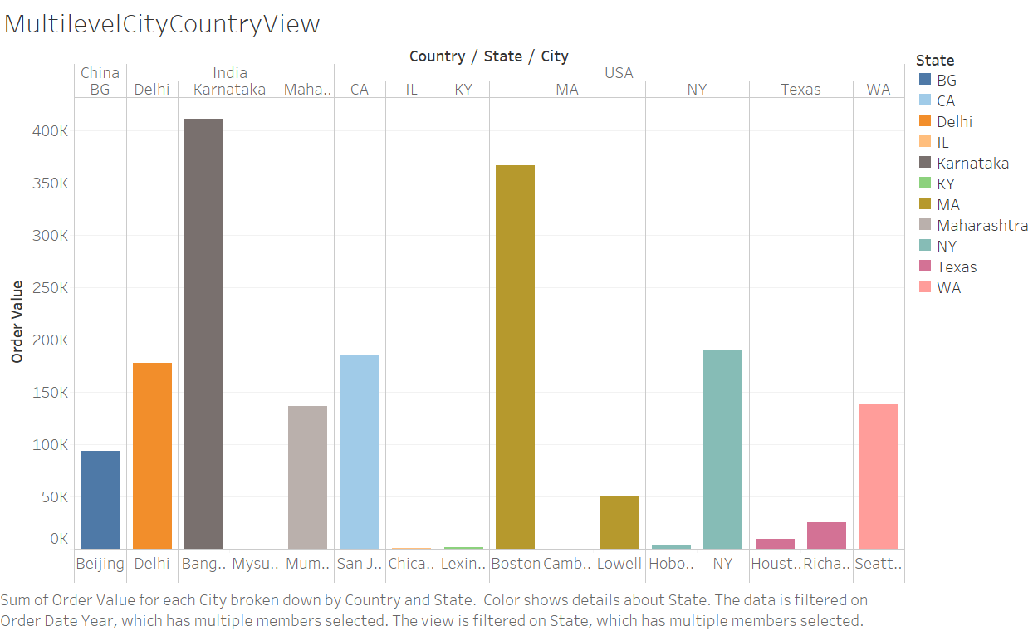
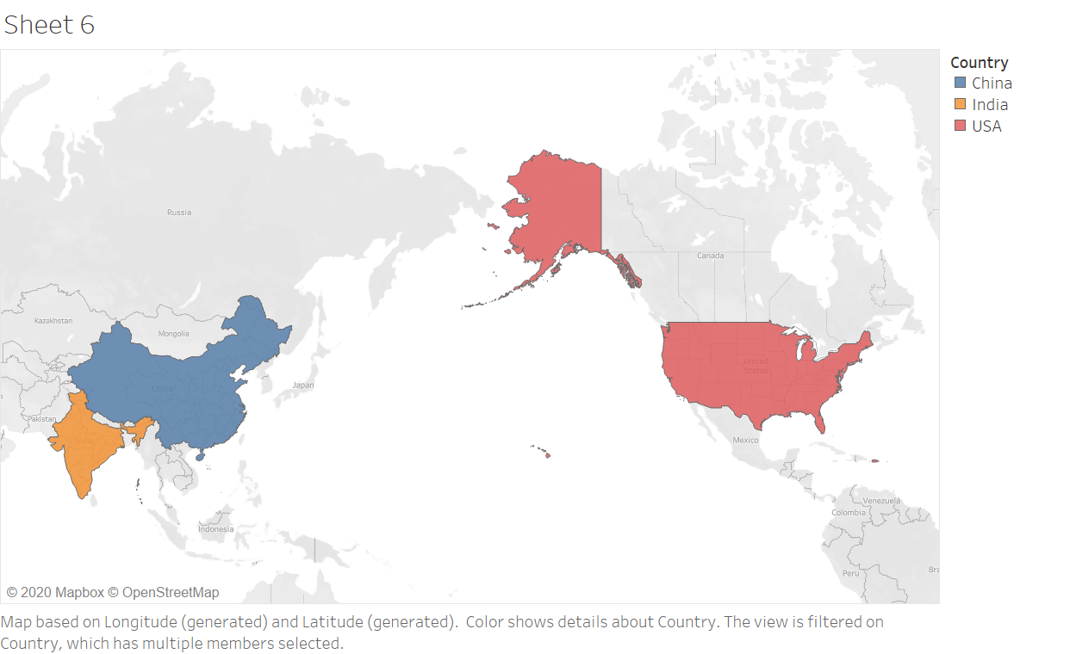

Slide 21

Thank You
Questions ?

